Slide 1
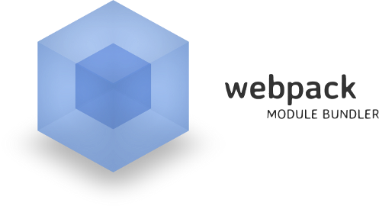
Webpack
Build Process, Basic Builds, Configuration
SoftUni Team
Technical Trainers
Software University
http://softuni.bg

Slide 2
Table of Contents
Introduction
What is Webpack?
Installation
Build Process
Basic Builds
Creating a Bundle
Configuration

Slide 3
Have a Question?
sli.do #JS-CORE

Slide 4

Webpack
A Wicked Smart Module Bundler

Slide 5



What is Webpack?
One of the newest tools, combining build steps and bundling
Bundles JavaScript files for usage in a browser
Supports dependency management
Can load any 3rd party library as a module
Comes with it's own development server
JS
JS
JS
JS
Bundle
CSS
CSS
CSS
CSS

Slide 6
Installation and CLI
Install Webpack via npm locally
--save-dev is used for production mode (development dependency)
Install the Webpack-cli
Used to run Webpack on the command line
npm install webpack --save-dev
npm install webpack-cli --save-dev

Slide 7

Webpack Build Process
JS
JS
JS modules with dependencies
JS
JS
JS
Stylesheets
Bundle
Deployment
CSS
CSS
CSS
Images and other assets

Slide 8
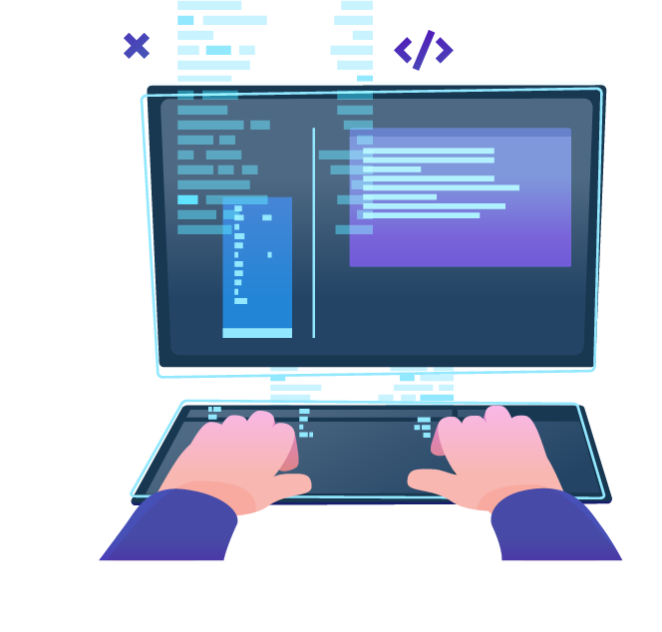
Basic Builds
Creating a Bundle

Slide 9
Getting Started
Run the following command to initialize a project:
Create a folder src
Inside it create files index.html and index.js
The project directory structure should look like this:
npm init --yes
webpack-demo
|- package.json
+ |- /src
+ |- index.html
+ |- index.js

Slide 10
Getting Started
Adjust package.json to prevent an accidental publish of code:
Mark the package as private
Remove the main entry
{
"private": true, // add
"main": "index.js", // remove
}

Slide 11
Creating a Bundle
To build a project for locally installed webpack, run either of the following commands:
If the main JS file is not named index.js, execute the following command to specify the name:
npx webpack
.\node_modules\.bin\webpack
\.node_modules\.bin\webpack .\src\myIndex.js

Slide 12

Configuration
Creating webpack.config.js file

Slide 13
Creating Configuration
Create webpack.config.js in your project folder
Entry - the name of the main source code file
Filename - the name of the file with minified code
const path = require('path');
module.exports = {
entry: './src/index.js',
output: {
filename: 'main.js',
path: path.resolve(__dirname, 'dist')
}
}

Slide 14
Creating Configuration
To run the build again using the new configuration file, use the following command:
To use the 'npm run build' command, adjust the package.json file by adding a 'npm script':
npx webpack --config webpack.config.js
"scripts" : {
"start": "webpack" "build": "webpack"
}

Slide 15
Loading CSS
To import a CSS file within a JavaScript module, install the style-loader and css-loader
Add the following code to webpack.config.js
npm install --save-dev style-loader css-loader
module: {
rules: [ {
test: /\.css$/,
use: [
'style-loader',
'css-loader']
} ] }

Slide 16

Summary
Arrow functions ≈ short function syntax
Webpack is a module bundler
It comes with its own development server
The "distribution" code is the minimized and optimized output of the build process
To load CSS, images, font and data, certain libraries have to be installed and imported

Slide 17
https://softuni.bg/courses/js-apps

Slide 18












SoftUni Diamond Partners

Slide 19




SoftUni Organizational Partners

Slide 20




Trainings @ Software University (SoftUni)
Software University – High-Quality Education and Employment Opportunities
softuni.bg
Software University Foundation
http://softuni.foundation/
Software University @ Facebook
facebook.com/SoftwareUniversity
Software University Forums
forum.softuni.bg

Slide 21

License
This course (slides, examples, demos, videos, homework, etc.) is licensed under the "Creative Commons Attribution-NonCommercial-ShareAlike 4.0 International" license

